Slide 1
Structure From Motion
Vincent Hock, Callum Taylor, Tomas Arevalo
ES143

Slide 2

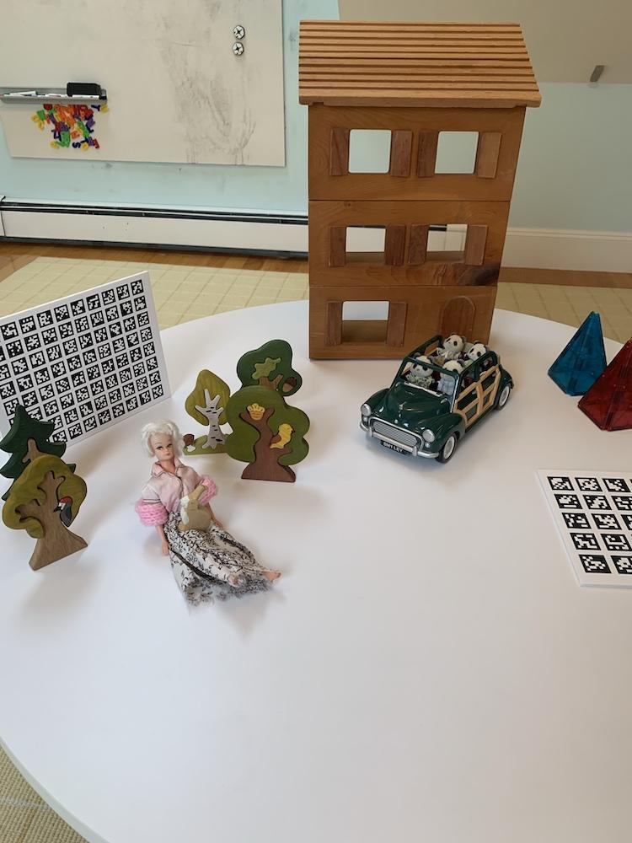
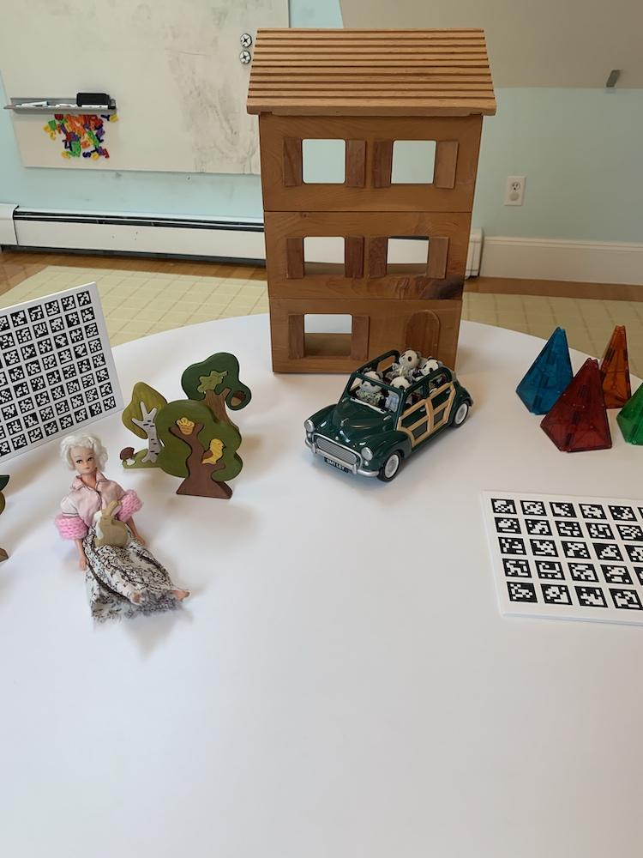
The Dataset (for now)

Slide 3
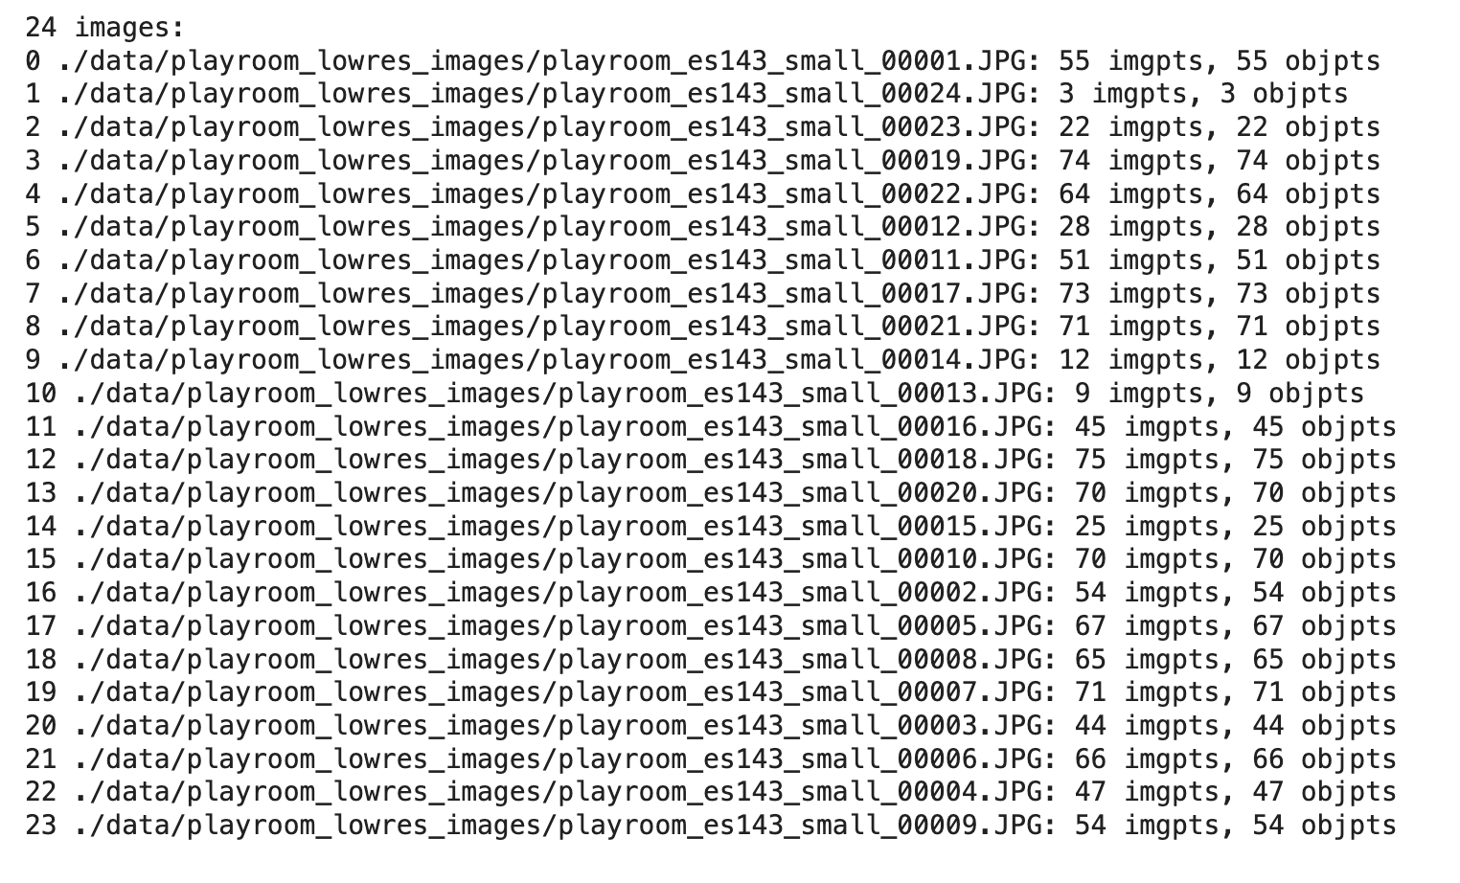
Calibration
Images instead of video

Slide 4
Base Scene From Two Views

Slide 5
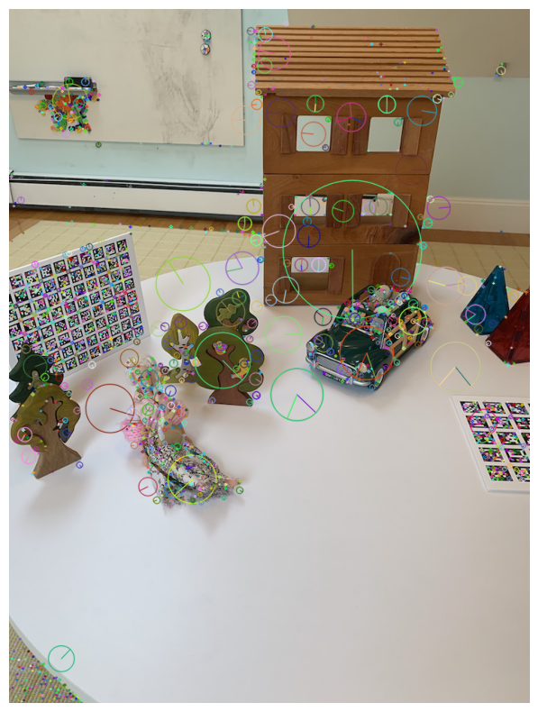
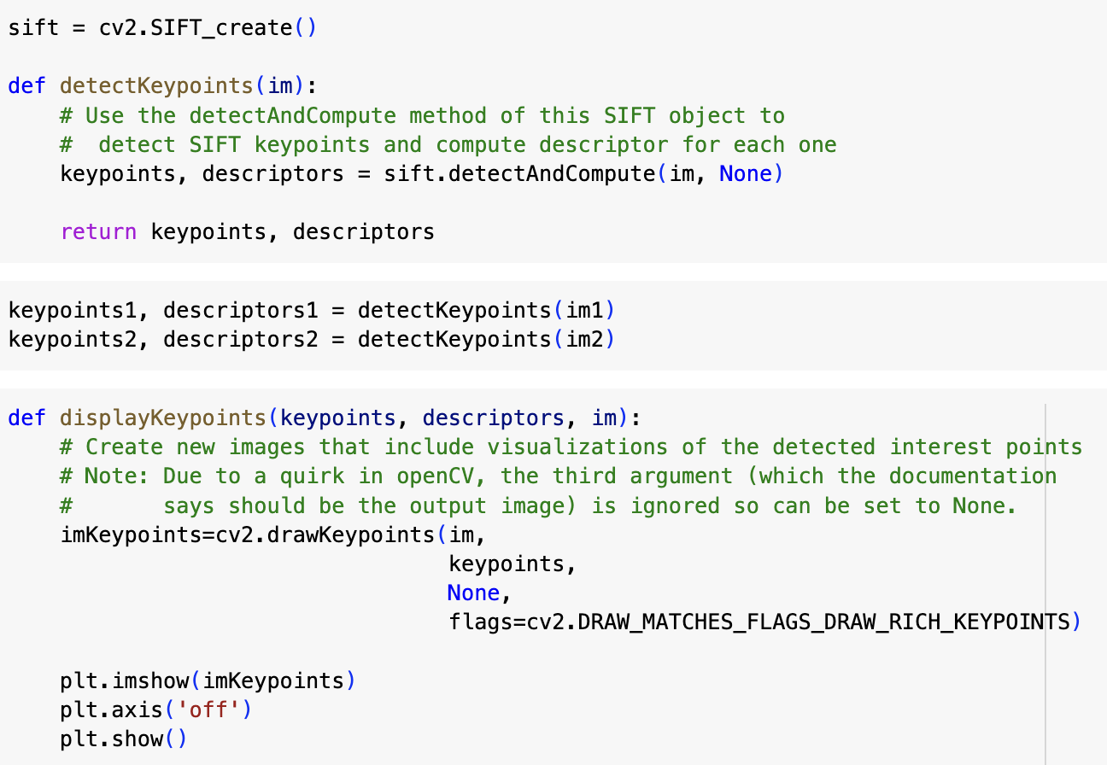
Keypoint Detection

Slide 6
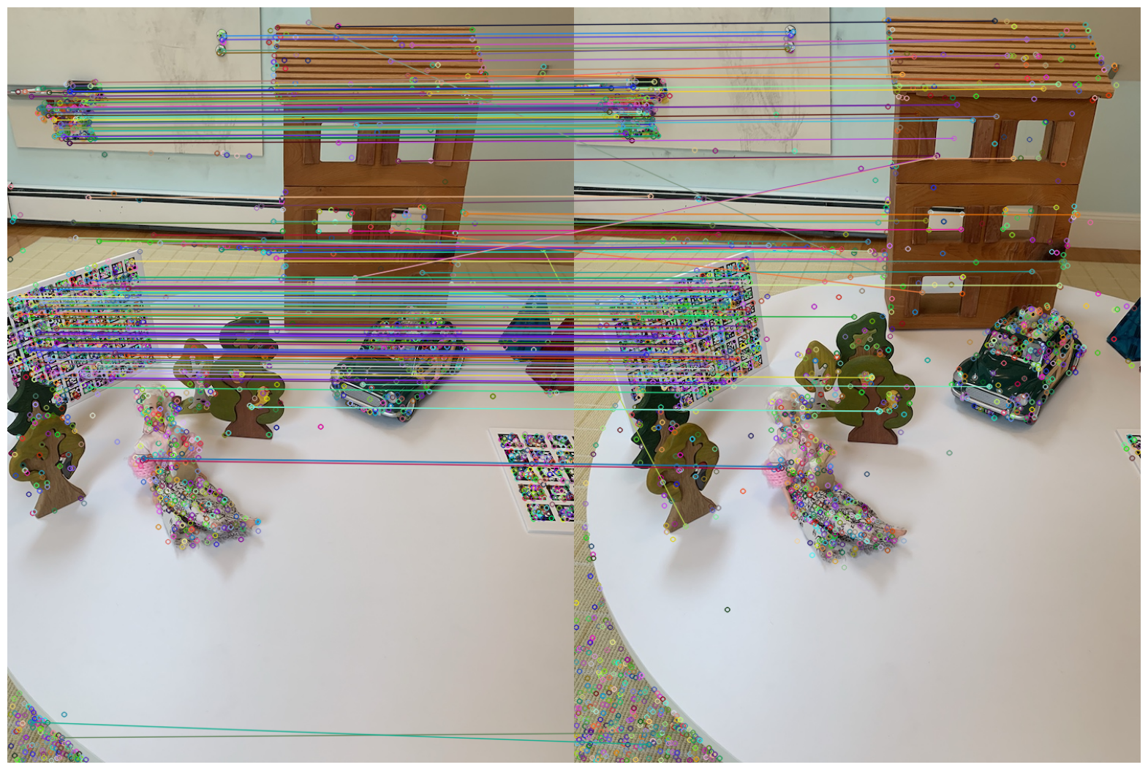
Keypoint Matching

Slide 7
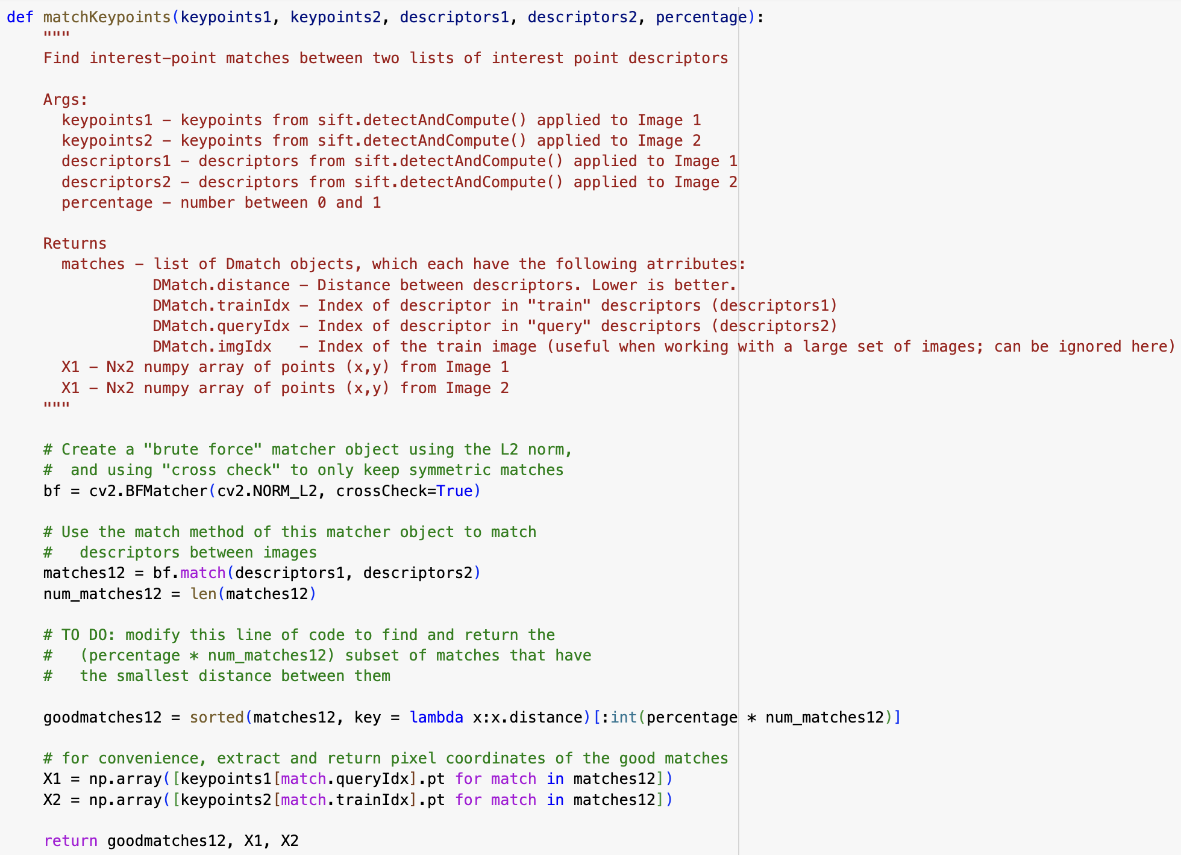
Keypoint Matching
20%

Slide 8
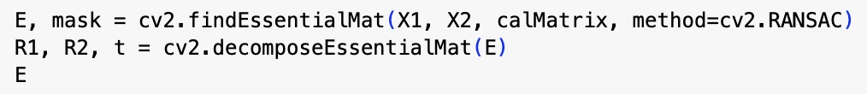
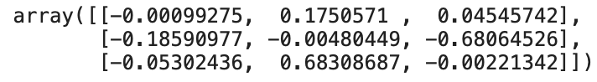
Essential Matrix & Decomposition
Used OpenCV’s functions
Notes:
Use mask for inliers vs outlier
R1, R2 represent rotation matrices for cameras
t represents translation vector from camera1 to camera2

Slide 9
Epipolar Lines Visualizations
Three Methods:
Essential Matrix + existing matched keypoints
Fundamental Matrix + existing matched keypoints
Fundamental Matrix + matched keypoints using a FLANN based matcher and David Lowe’s ratio test (via OpenCV)

Slide 10
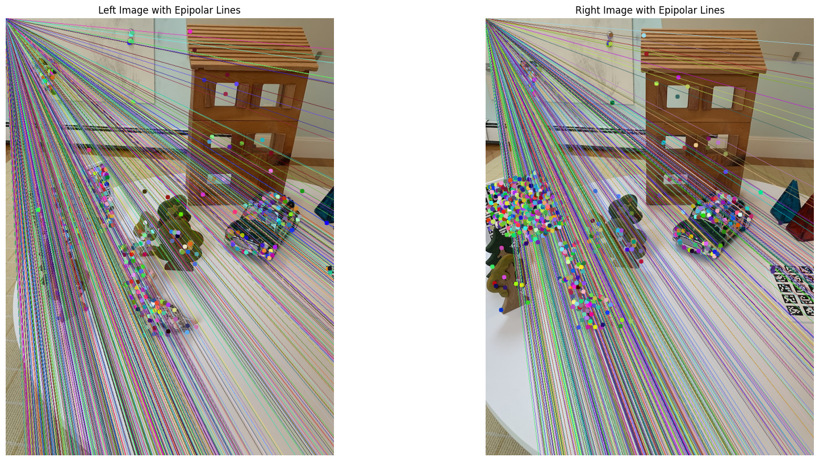
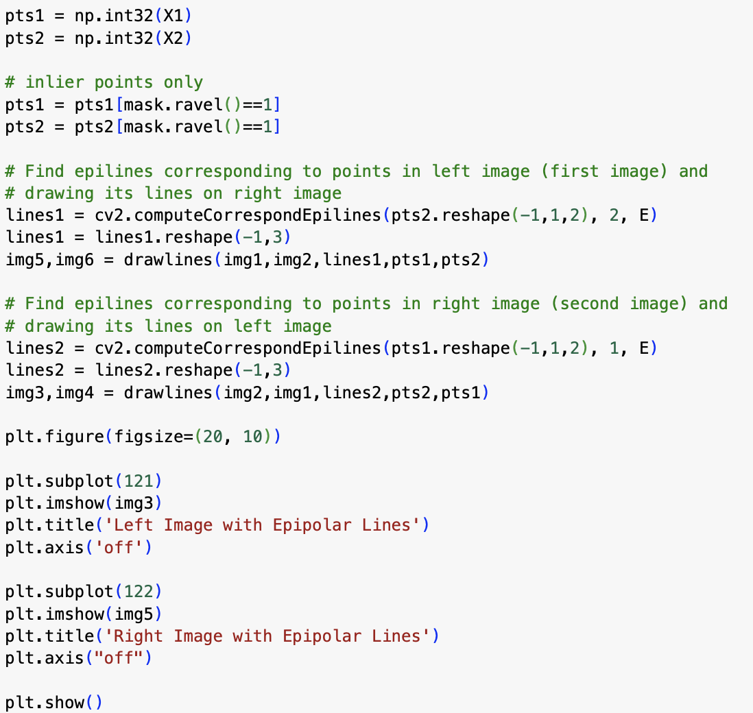
Method 1: Essential Matrix + Matched Keypoints

Slide 11
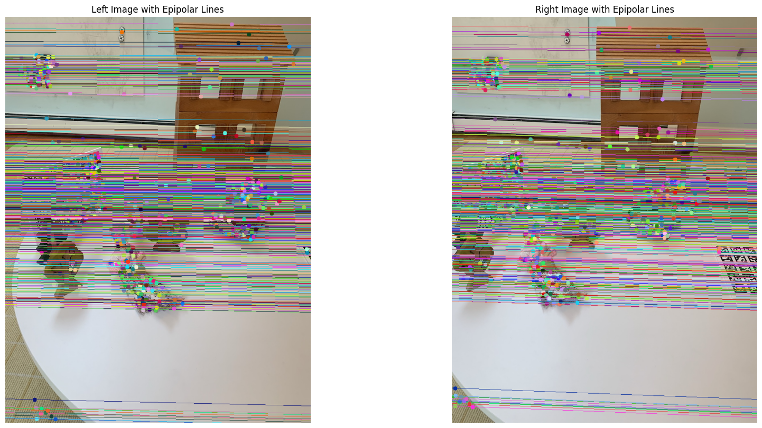
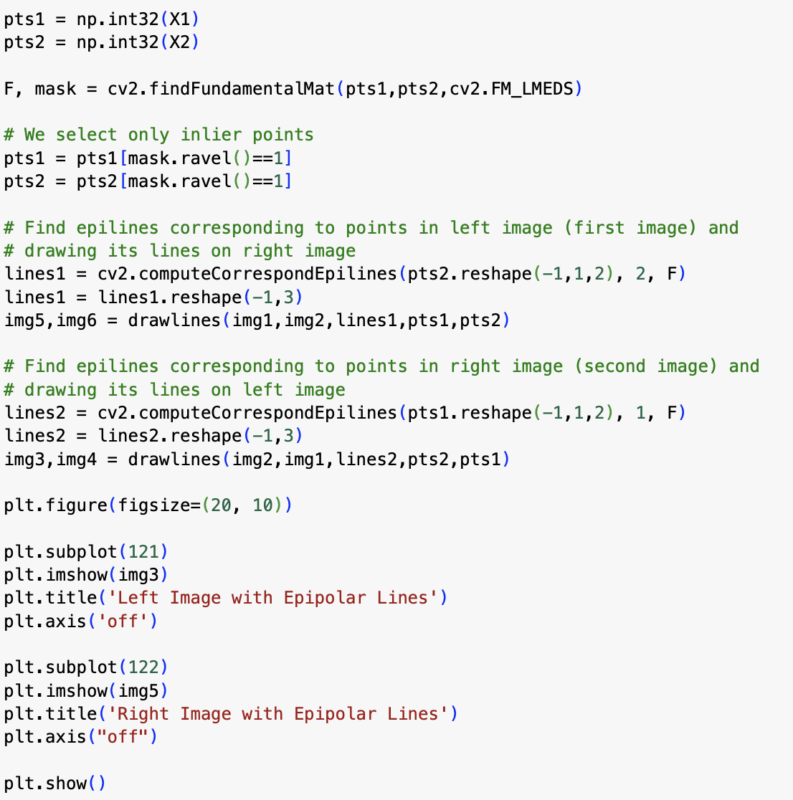
Method 2: Fundamental Matrix + Matched Keypoints

Slide 12
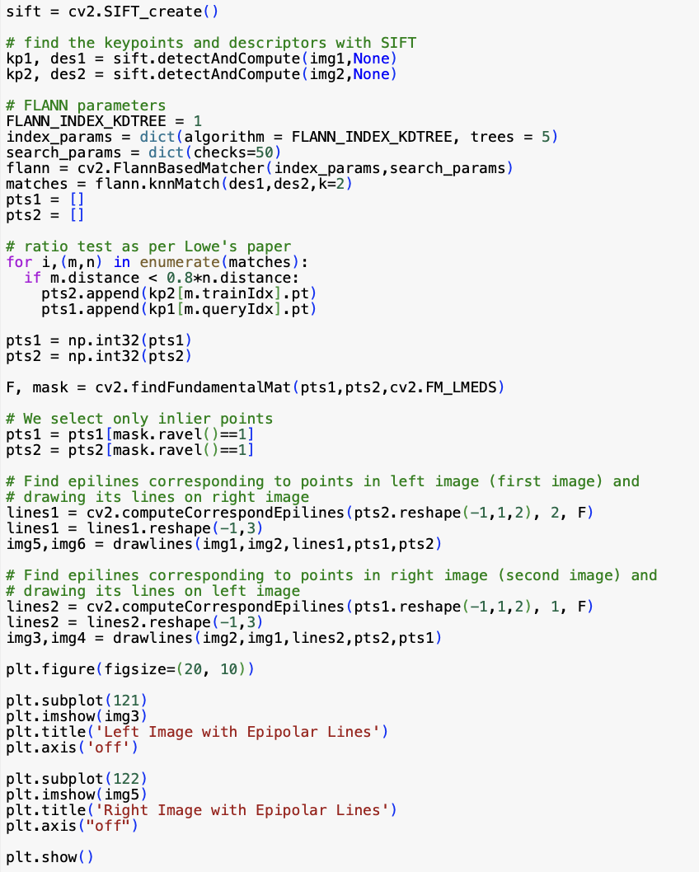
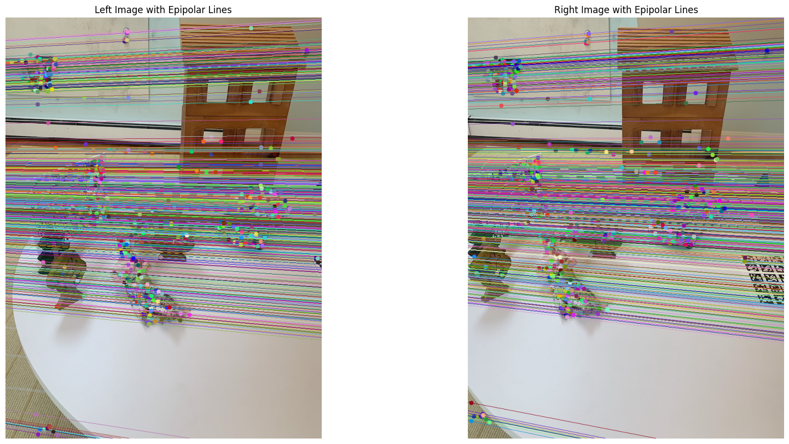
Method 3: Fundamental Matrix + New Matched Keypoints

Slide 13
Takeaways/Questions from Epipole Visualizations
BFM matches vs FLANN matches produced similar results
Using the Essential Matrix seemed to produce incorrect results
When to convert the matched keypoints to integers?

Slide 14
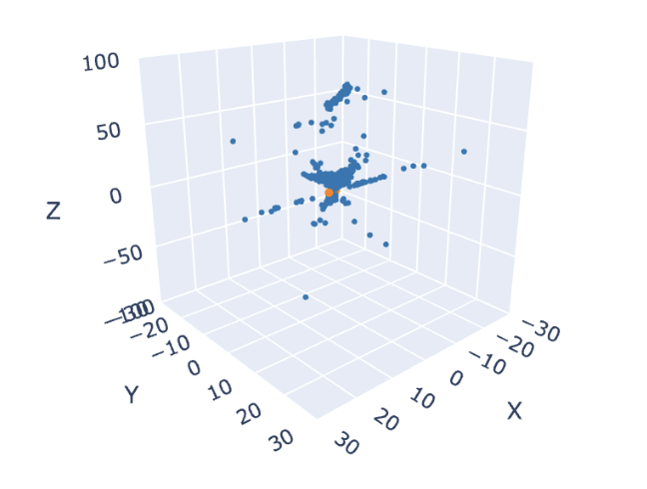
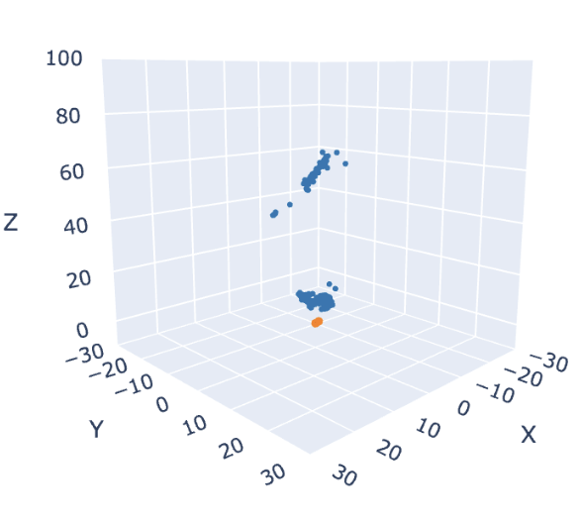
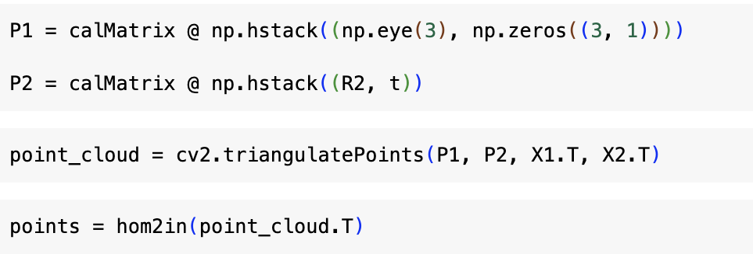
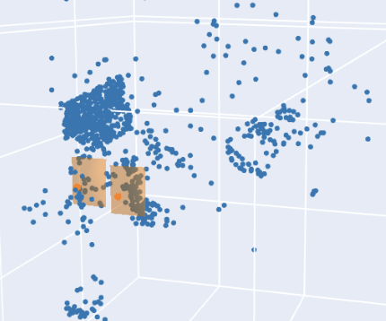
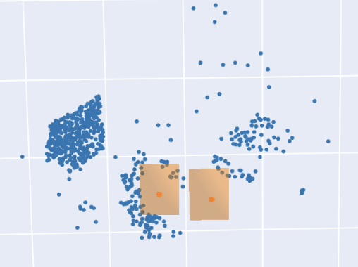
Triangulation

Slide 15
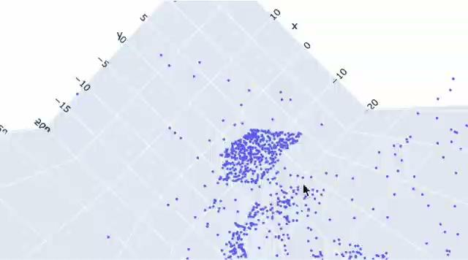

Slide 16


Slide 17
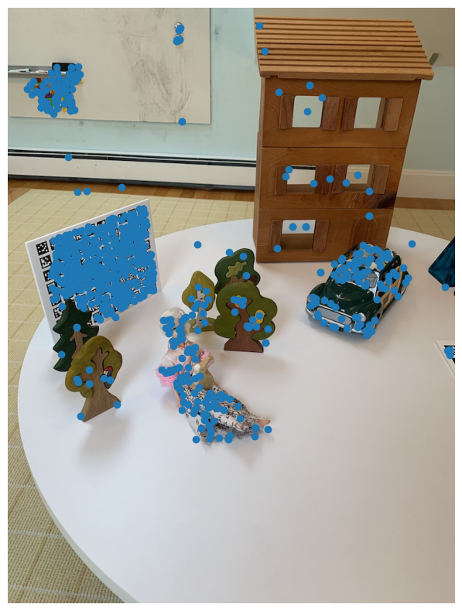
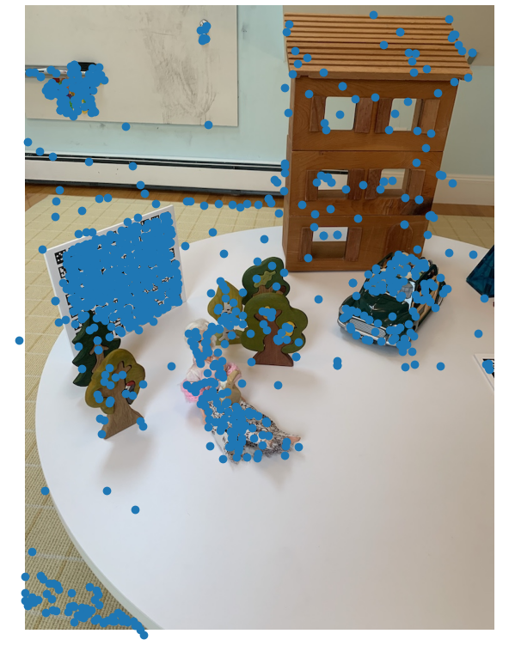
Triangulation: Sanity Check
Projection of 3D points back onto image using camera matrix P

Slide 18
Adding Additional Views

Slide 19

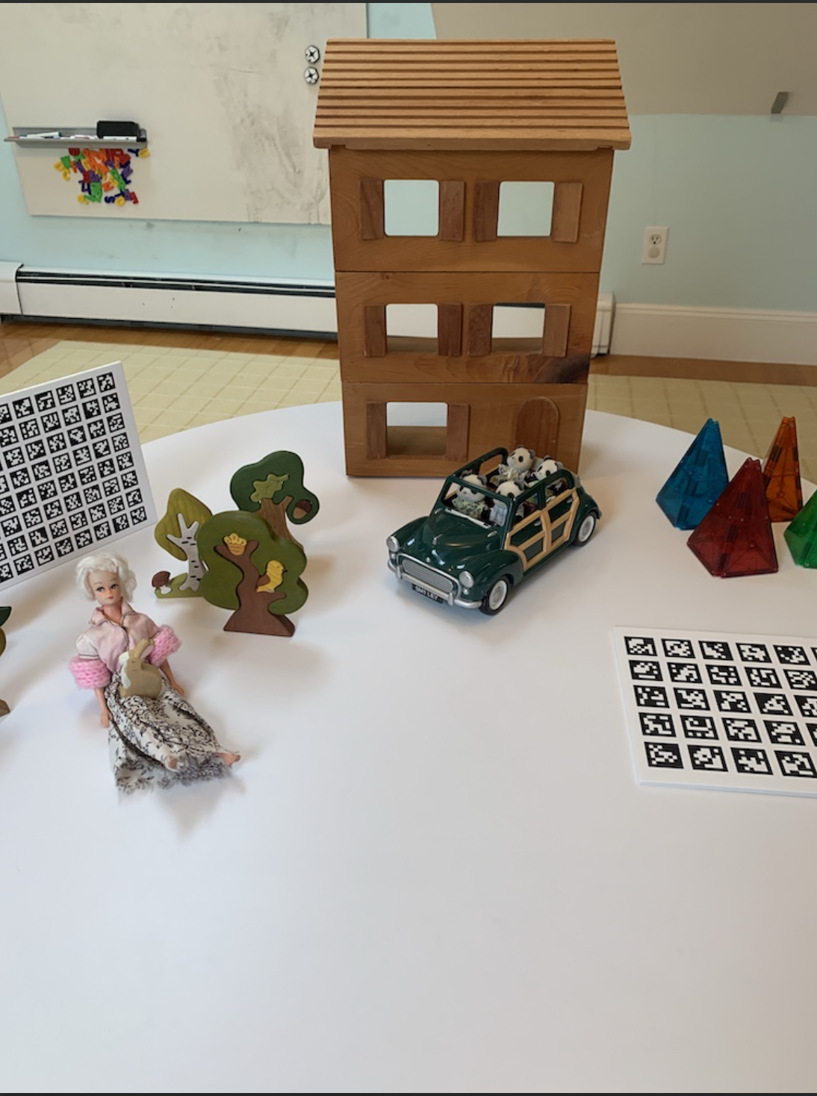
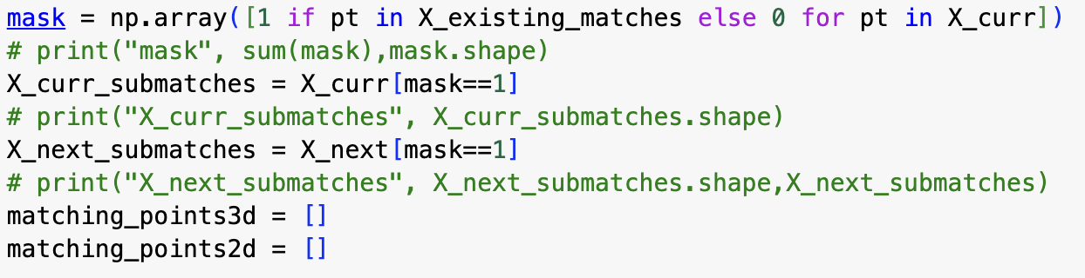
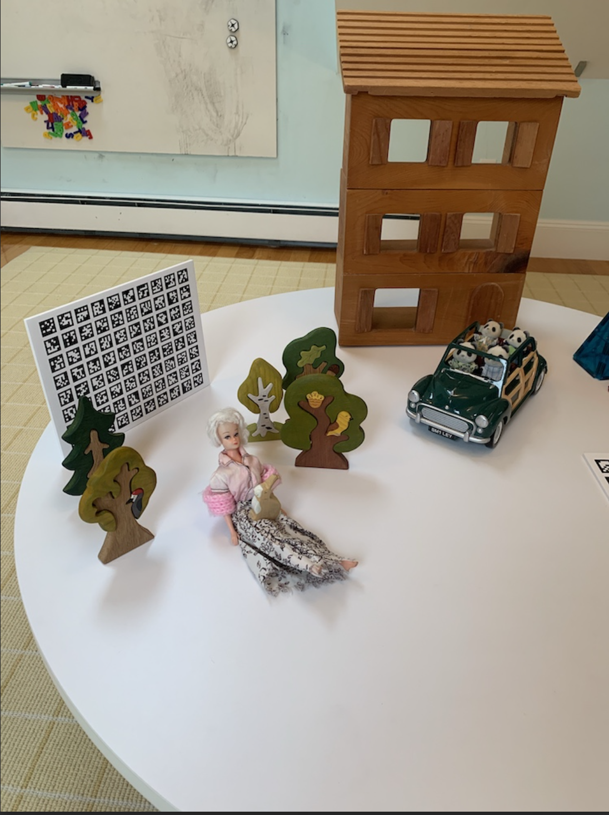
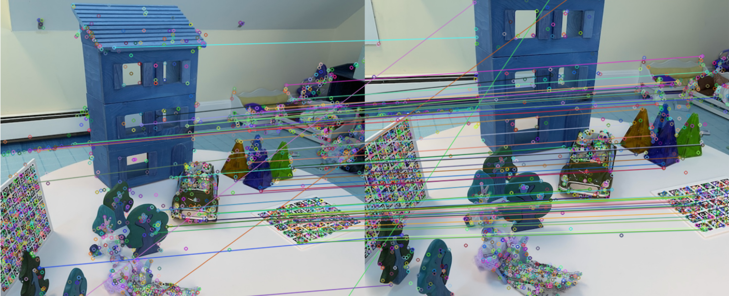

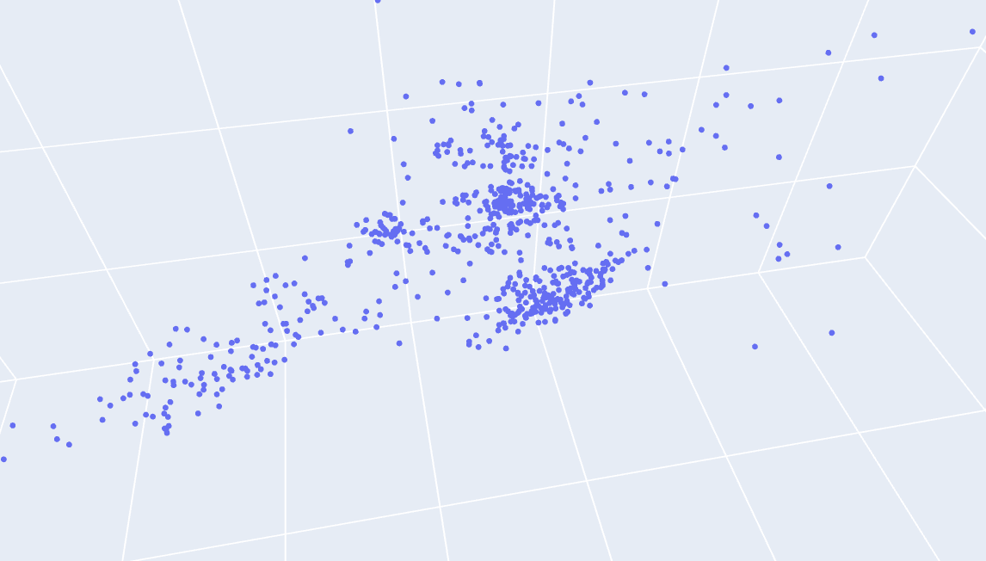
PnP Solver
The Pipeline
2
3
1
2
Compute point cloud from the 1st and 2nd image using the standard approach.
Take 2nd and 3rd image and find matching keypoints.
Mask matching points from 1st/2nd image to the 2nd/3rd image.

Slide 20
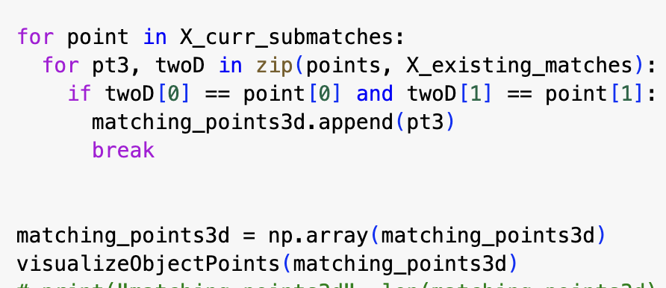
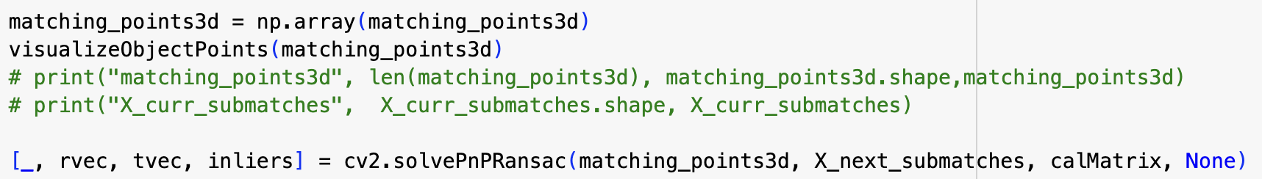
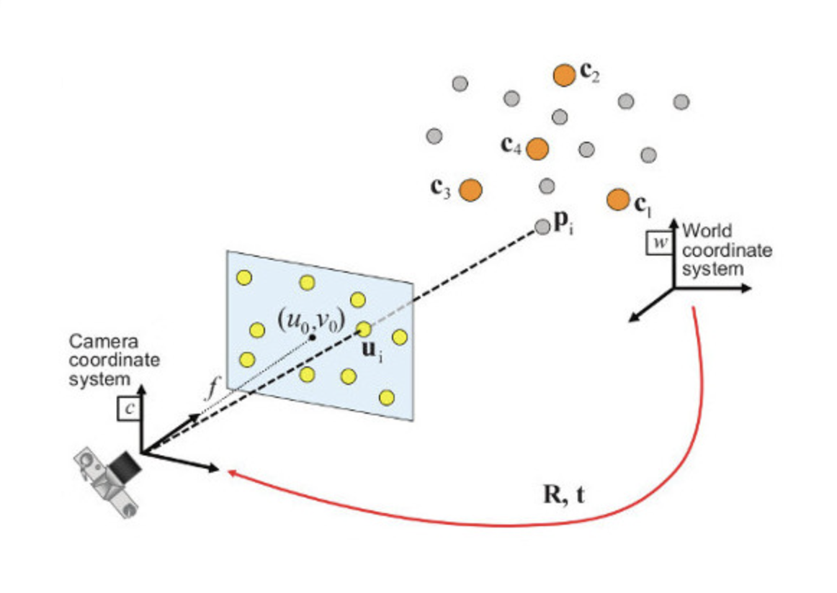
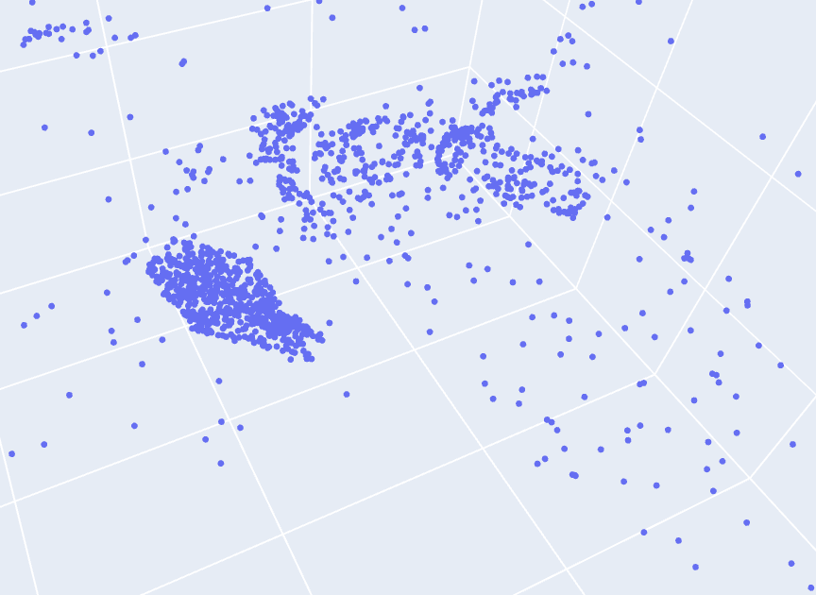
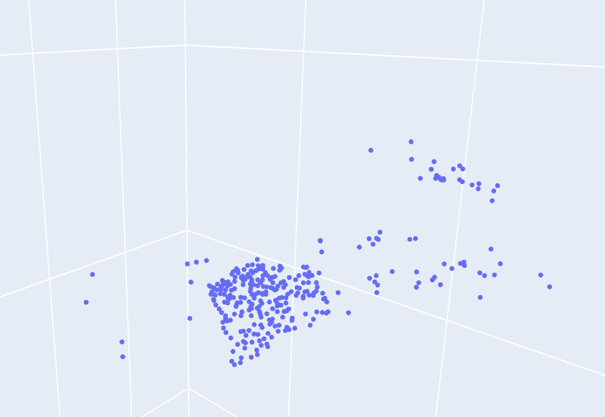
PnP Solver
The Pipeline
Find respective 3D coordinates of overlapping points.
PnP algorithm matches previous 3D points with new 2D image points.
Output is a translation and rotation vector applied to the new 3D points.

Slide 21

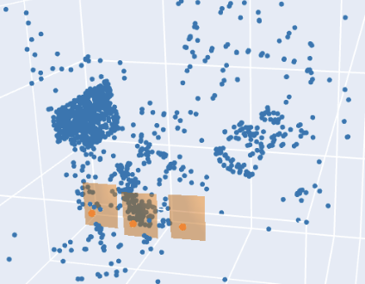
Triangulate & Concatenate
We repeat the same triangulation process with the new R and t values.
New points are concatenated with the existing point cloud to create the 3D structure.
1
2
3

Slide 22
What’s Next

Slide 23

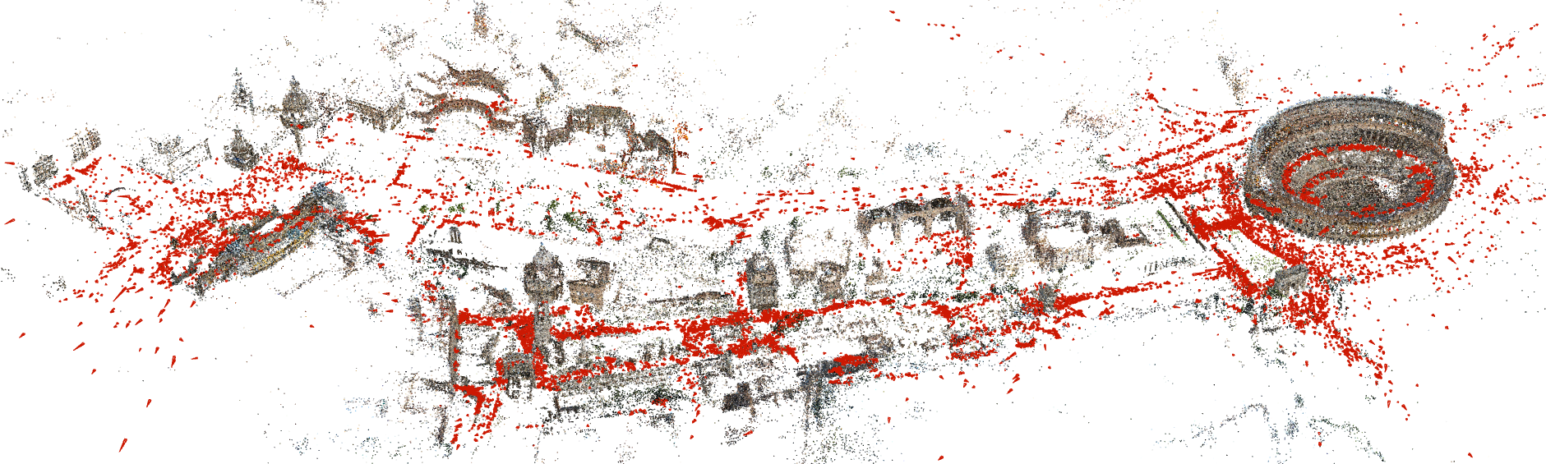
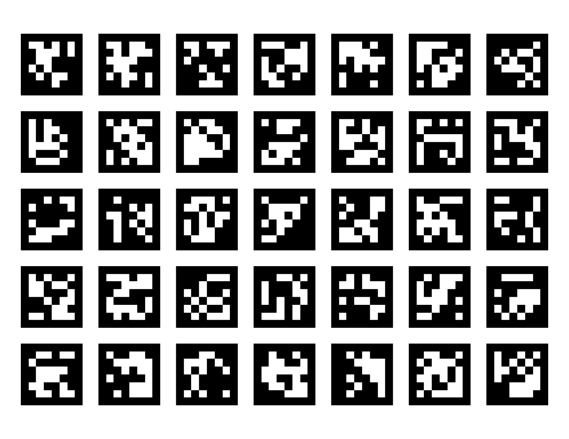
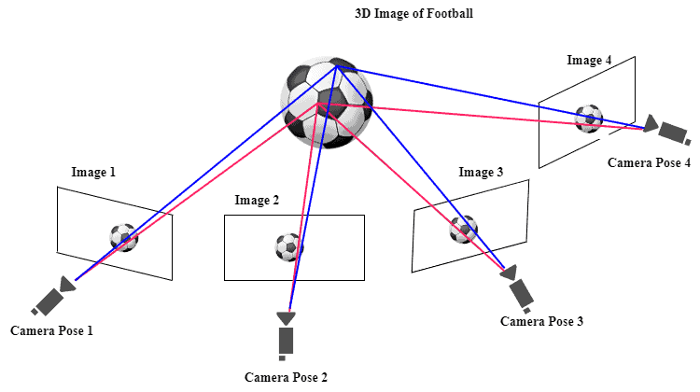

Bundle Adjustment
COLMAP Comparison
Removing Fiducials
Clean Up Outliers

